Slide 1

‘
VACCINE EQUITY AND ACCESS
11 March 2021**
IMAGE CREDITS:
PEOPLE’S VACCINE, FREE THE VACCINE,
MSF, FP, EIU, kei, Duke, BBC,

Slide 2

The People’s Vaccine
Everyone, everywhere, who needs it, must get a safe and effective vaccine
COVID-19 diagnostic tools, treatments, and vaccines must be available to everyone everywhere, free at the point-of-delivery
Peoples Vaccine - http://peoplesvaccine.org/
UAEM – Free the Vaccine https://freethevaccine.org/

Slide 3
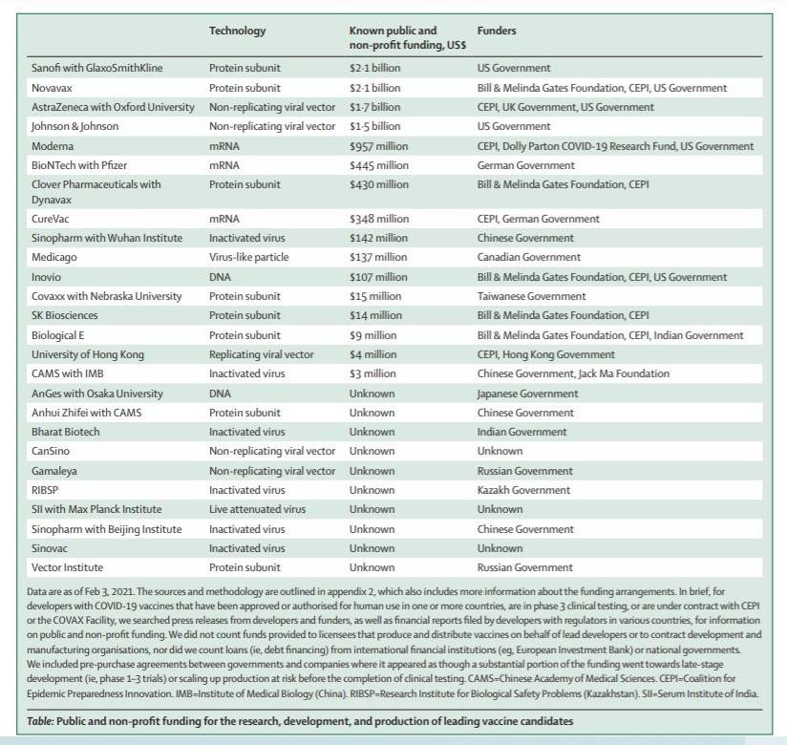
THE LANCET: Challenges in ensuring global access to COVID-19 vaccines:
Olivier J Wouters et al (12 Feb 2021)

Slide 4
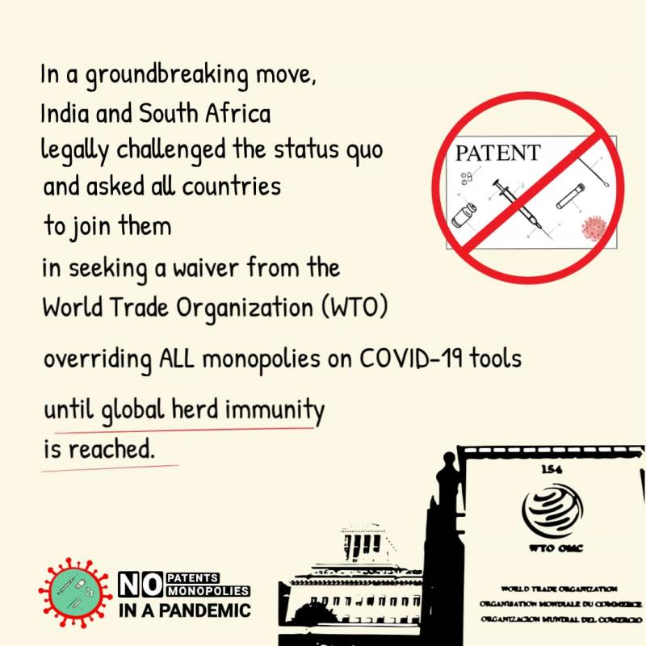
‘Why TRIPS WAIVER’ matters
SA Government Submission to WTO: July 2020
  ‘TRIPS flexibilities are difficult to use, rarely invoked by Global South’
AU Communique on IP Barriers for Vaccine Access: July 2020
SA and Indian Government Joint Proposal for TRIPS Waiver : October 2020
  Now supported by many developing world countries, co-sponsored by 57 and AU, Vatican, WHO, other moral and public health leaders and science experts
  Opposed by Brazil (BRICS-), Australia, EU, UK, US, Canada, Japan

Slide 5
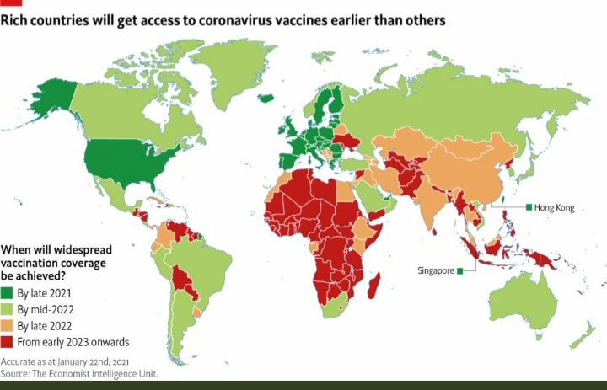
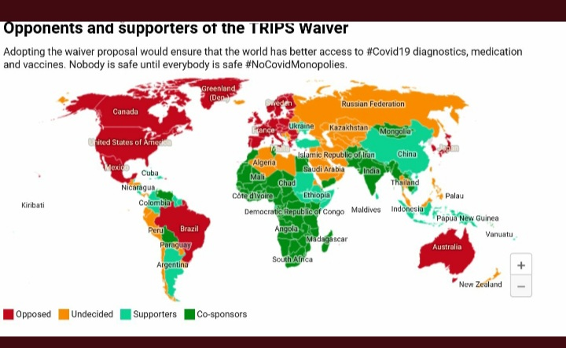
Access and blockers of access
(MSF / EIU / Duke)

Slide 6
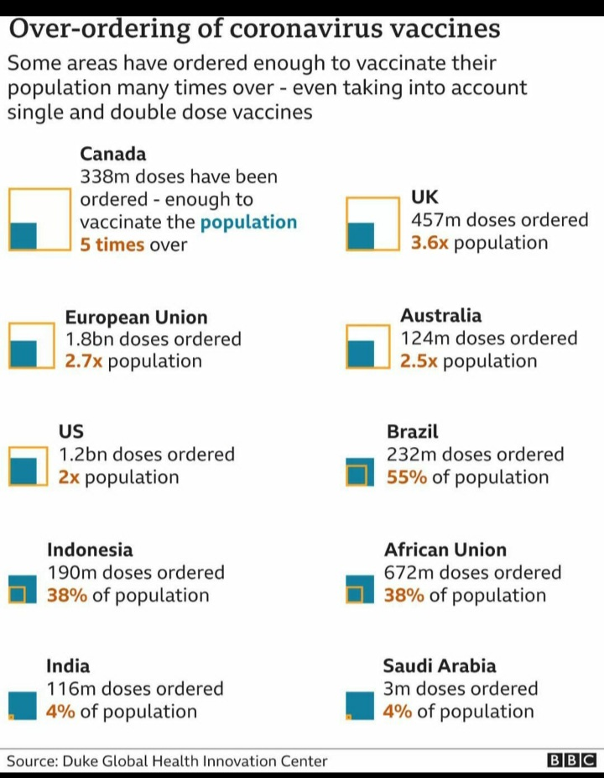

Slide 7
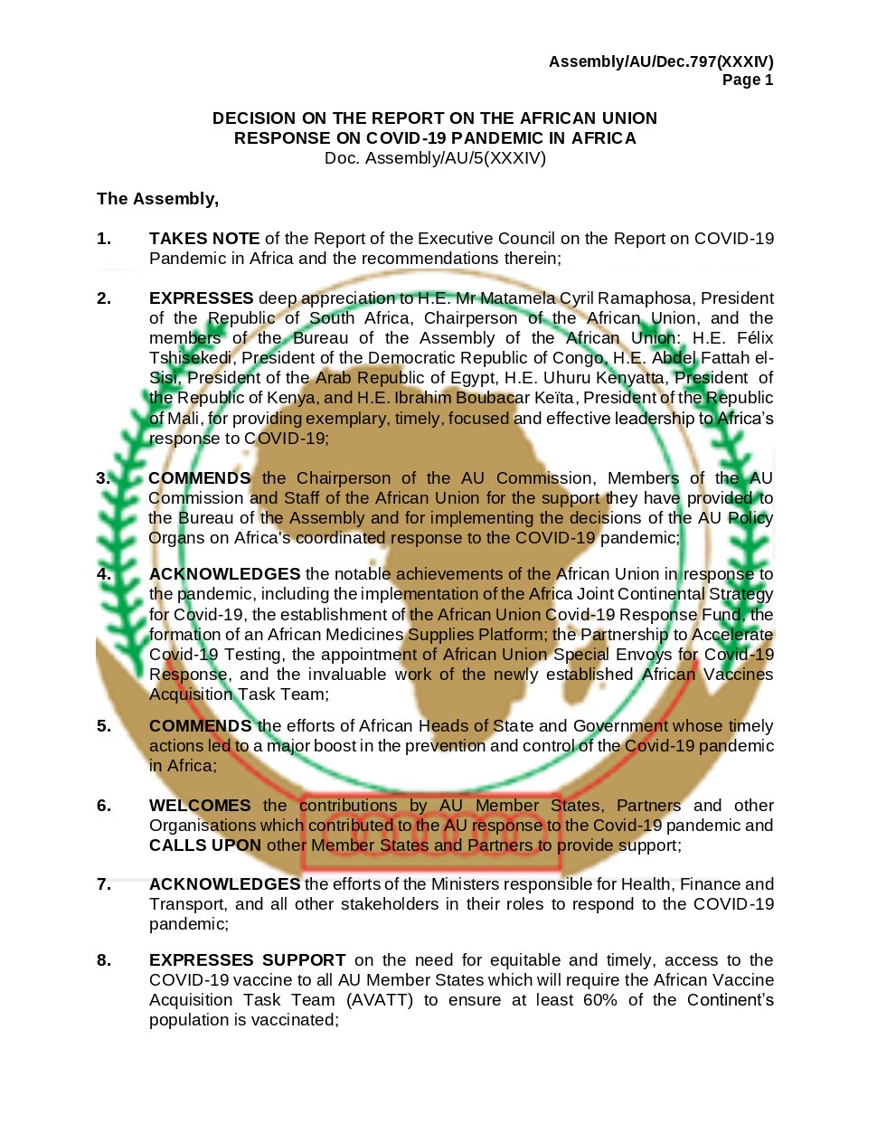
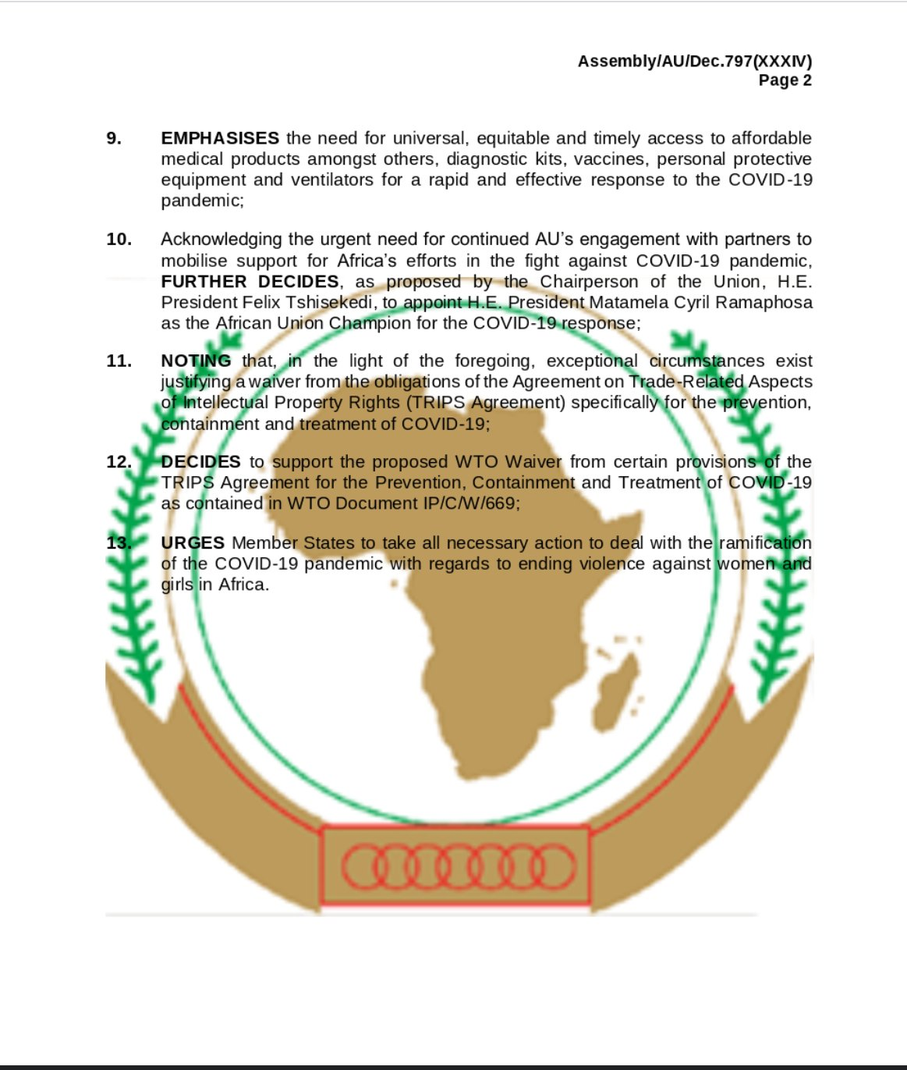

Slide 8
1 year to pandemic declaration - where are vaccines?
75% of vaccines administered in 10 rich countries- 130 countries – zero or handful of shots administered (WHO)
COVAX has several limitations – Austria has questioned lack of transparency
  Voluntary pooling mechanism; tiered pricing
  Self-financing for MICs and HICs (Canada, UK) alongside bi-lateral agreements
  Not all governments and companies have entered (MoU, SoI)
  No pricing transparency or contract disclosure - forfeiture fee exists - other penalties unclear
  Relies on charity for LICs – not yet raised full target
  Supply targets cannot cover Q 1 needs – best estimate 27% by end 2021
  Key pillar is AZ via Korea BK/Serum II*
WHO – this is a ‘moral catastrophe’ / supports waiver and patent relaxation for pandemic
WHO – and Dr Fauci, Vatican, AU, UNAIDS, Stn Africa Anglican Archbishop:
  relax the patent regime, stop hoarding, share technology and urgently scale up for public health reasons too - widespread urgent global and esp. HCW immunisation needed

Slide 9
South Africa – impact locally
SA HCW – first study vaccine mid-February 2021 (Sisonke study for HCWs)
  Budget announcement includes ZAR 20 billion and no-fault state sponsored scheme
  Regional impact given migrant labour if only SA vaccinates first Stn Africa
Vaccine Selection and Trials
  Trial- AstraZeneca/Oxford Group (roll out paused early 2021; ‘selling’ to AU) (EU export ban)
  Trial - Johnson and Johnson (Sisonke+ rolled out 17 Feb. 2021)
    Aspen sub-license only for fill and finish - J&J (issue around volumes and exports)
    No BIOVAC license – (COVAX pre-selected, not materialised)
  Trial - Novavax (not in selection)
  Trial - Pfizer/BioNtech (in selection)
Selection of vaccines and phase roll out implications in absence of regulatory approval, variants and bi-lateral and COVAX and AU VATT agreements (COVAX depends on AZ as pillar)
Other discussions (Russia, China) and negotiations pending with Moderna Inc (NIH-Moderna Vaccine)

Slide 10
Africa ++
Africa: AU VATT -700 mill from COVAX, 270/300 from AU bi-lateral deals with J&J, AZ, Pfizer, + (?)
  This week: first supplies arrived in Africa from COVAX
    20 million for 20 countries – unlike Jan. 2021 (‘25 shots’), now include Ghana, Ivory Coast, Kenya vaccinating
    Deliveries also to- Angola, DRC, Cambodia, Colombia, DRC, Gambia, India, Kenya, Lesotho, Malawi, Mali, Moldovia, Nigeria, Philippines, RO Korea, Rwanda, Senegal, Sudan and Uganda
    COVAX expecting 14.4 million for additional 31 countries this or next week = 51 countries (2/3% by end Q1 / 27% max coverage in LICs by end 2021)
    “relatively small’ volumes a risk and means widespread immunity will be delayed in Africa and global south unless urgent manufacturing scale up takes place to address immunological equality
Countries also negotiating with COVAX outside of AVATT

Slide 11
Civil Society
Access cannot hinge on benevolence and charity and no transparency (see also WHO)
Billions in public investment including for vaccine research for Covid-19 (see Lancet)
Voluntary licenses are limited and non-transparent, even if helpful – segments markets – who has ultimate control and rights (to IP)
Rich countries have pre-bought supplies in advanced purchase agreements, bi-laterally (see pre-orders)
COVAX has several limitations TRIPS flexibilities are difficult to use in practice (see WHO and forecasts)
Health / Justice Groups Calls on 1 year of pandemic declaration:
  Pharmaceutical companies must openly share their technological know-how also by joining the WHO Covid-19 Technology and Access Pool (C-TAP)
  Governments must suspend patent rules at the WTO vaccines and health technologies during the pandemic. This will help break monopolies and increase supplies so that there are enough doses for everyone, everywhere
Safe manufacturing can be ramped up with proper investment and data sharing:
  Way 1 (Waiver); Way 2 (Doha);
  Now Way 3 (‘WTO way’ - still enforces patents despite Doha and AIDS crisis lessons)
  Way 4 ‘WHO Way’ – Who, COVAX plus meeting with manufacturers and governments to id bottlenecks and remedy (tech transfer focus)
  Way 5 – Australia +

Slide 12
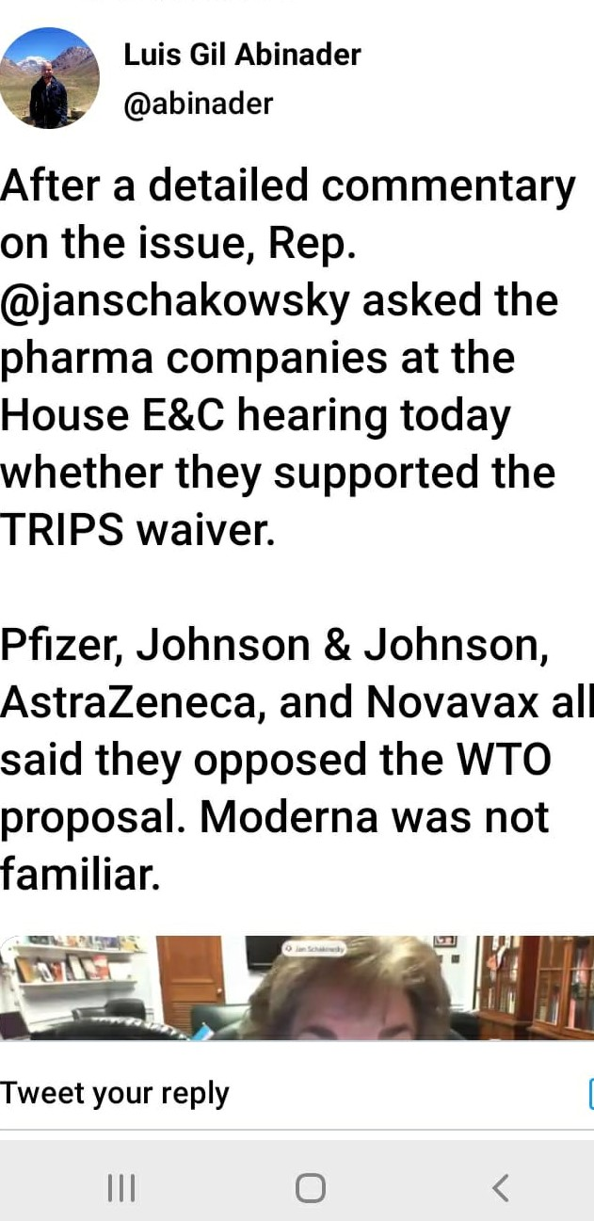
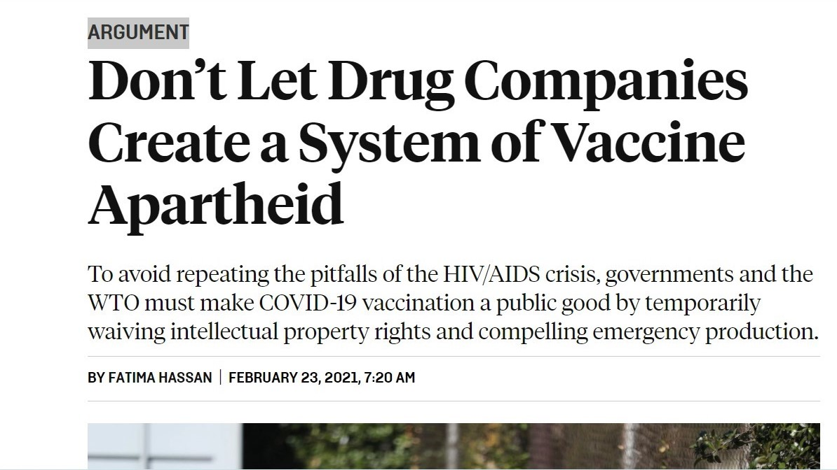
Vaccine Apartheid

Slide 13
