Slide 1

The Privatisation of the COVID-19 Vaccine: Exploring law and equity impacts
Sharifah Sekalala
Warwick Law School
Image credits Financial Times, Metro, Tom Hartman, Google images

Slide 2
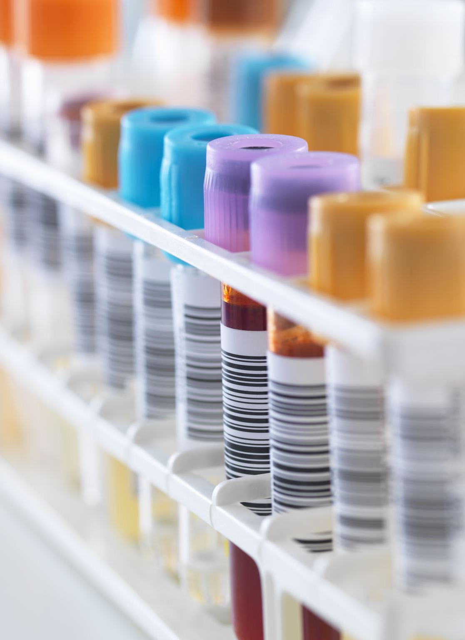
INTERNATIONAL LEGAL FRAMEWORKS
ICESCR: Right to Life/Right to Health
TRIPS Agreement 1995
Doha Declaration on TRIPS Agreement and Public Health 2001

Slide 3
DEBUNKING THE R&D RATIONALE
COVAX contributed 2.4 billion doses before the end of 2021 for COVID-19 vaccines
Similarly many governments also contributed funding for R&D research.

Slide 4
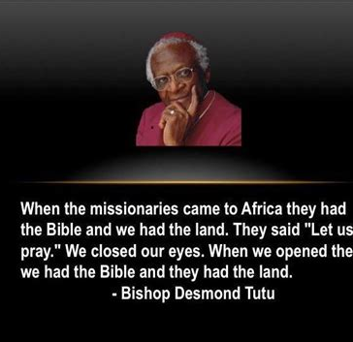
BEYOND PUBLIC GOOD RHETORIC: REPRODUCING INEQUALITY THROUGH COVAX

Slide 5
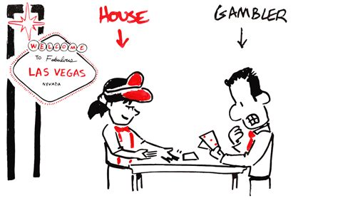
THE HOUSE ALWAYS WINS
COVAX : DUAL TRACK SYSTEM
Canada has opted to take 1.9 million vaccine doses from the global distribution mechanism, leaving fewer jabs available for countries that are entirely reliant on COVAX.
Bilateral Agreements

Slide 6
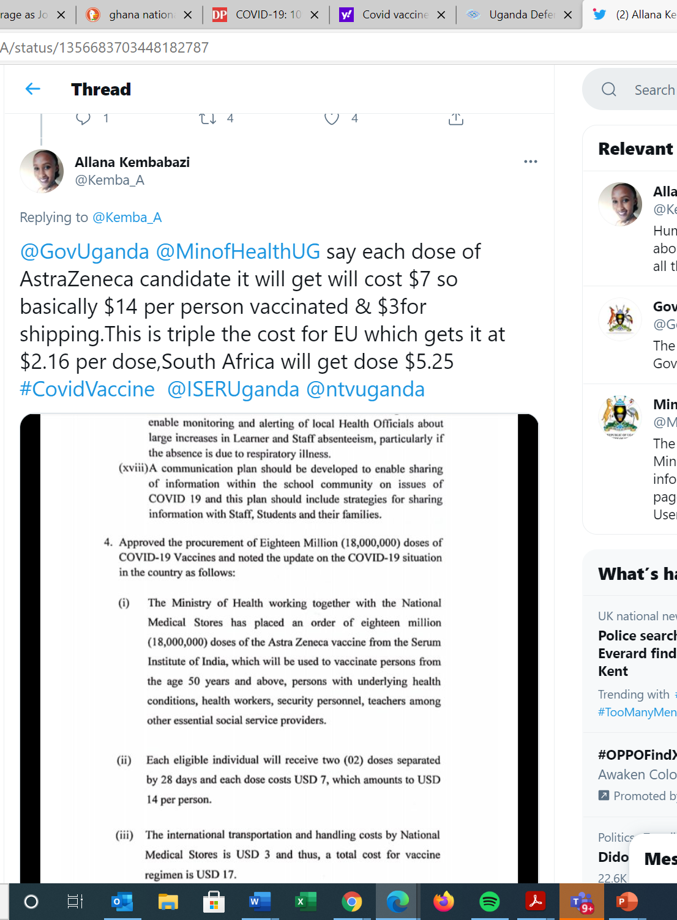
Bilateral Agreements

Slide 7
REPRODUCING PRIVATISATION AT THE NATIONAL LEVEL
Public -Private distinctions/ Another dual track system?
In Egypt, authorities announced last week that it would cost $12 for two doses of one of the vaccines it secured, a move likely to deter the poor - already dealing with strained economic conditions - to seek out a vaccine.
Corporations as distributors of vaccines
The digitisation of access for COVID-19 vaccines
Lack of transparency about national vaccine allocation (Inner circles)

Slide 8
Who is the front of the queue?
The ministry of health has received another consignment of 10,000 doses of the Astra-Zeneca vaccine from the government of India. The ministry now has 964000 doses that will be used to vaccinate teachers, health workers, special interest groups and security personnel.
India launched its vaccination drive on 16 January, but it was limited to healthcare workers and frontline staff. From March 1, the eligibility criteria expanded to include people over 60 and those who are between 45 and 59 but have other illnesses.

Slide 9
An alternate approach that focuses on social determinants of health
Sekalala S, Perehudoff K, Parker M, et al, ‘An intersectional human rights approach to prioritising access to COVID-19 vaccines, ‘BMJ Global Health 2021;6:e004462. https://gh.bmj.com/content/6/2/e004462.share
The Value of Human Rights for Vaccine Prioritization at the National Level – Health and Human Rights Journal (hhrjournal.org)

Slide 10
VACCINE TOURISIM
In December, an Indian travel was "taking registrations of Indians with a valid 10-year US visa" for their COVID-19 vaccine package—a four-day trip from Mumbai to New York City, with a coronavirus shot included. The cost? Around $2,000, reported NBC News.
In January, there were reports that Johann Rupert, who is from South Africa, had been vaccinated privately in Switzerland before vaccination efforts in that country began.

Slide 11
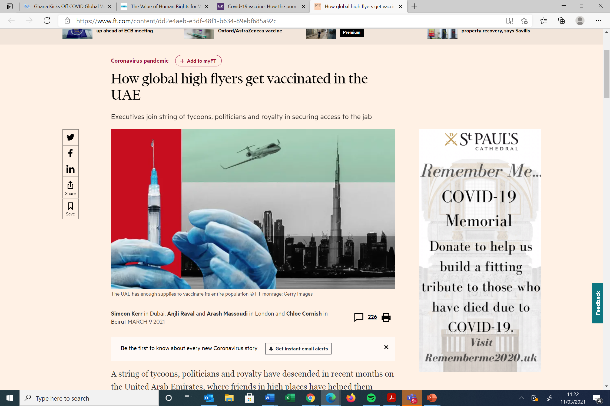
Compounding Global Inequity

Slide 12
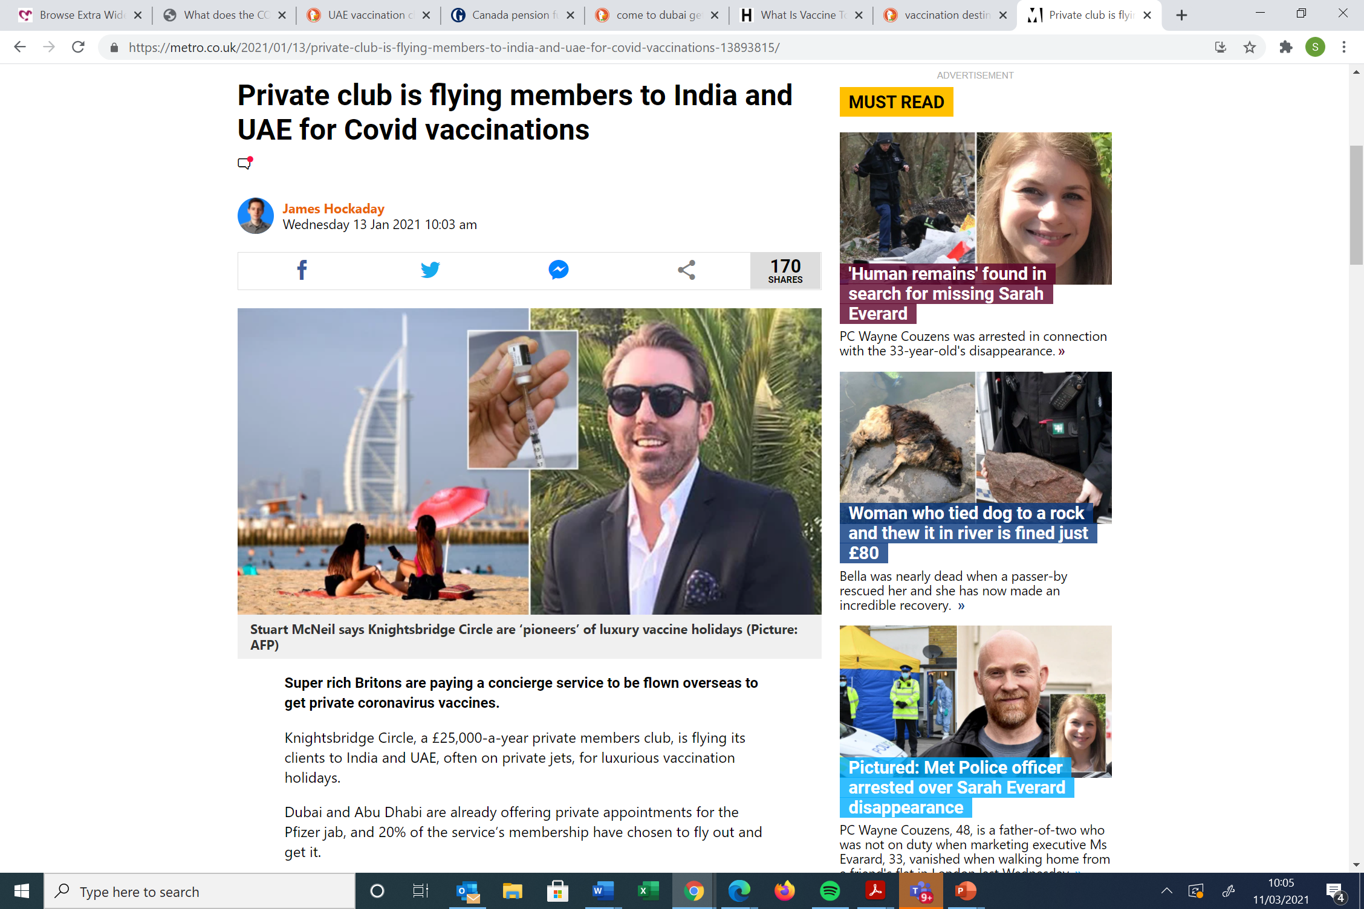
HAVE A HOLIDAY AND JUMP THE QUEUE!

Slide 13
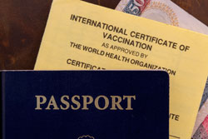
THE END OF COVID-19? VACCINE PASSPORTS

Slide 14
